Slide 1
Coverage-Based Test Design CS 4501 / 6501 Software Testing

Slide 2
Today’s Objectives
What is criteria-based test design?
Why are test criteria used?
Who will benefit form using test criteria? How?
When are test criteria used?
How are test criteria used?
What are existing criteria? How are criteria categorized?
Which criterion should be used? When? Why? How?
Starting next lecture

Slide 3
All Possible Inputs?
Let’s do activity
Create all possible test inputs for the given program
It is impossible to provide all possible inputs
Therefore, we need some rules to help us decide which inputs to enter and give us an idea if we test enough

Slide 4
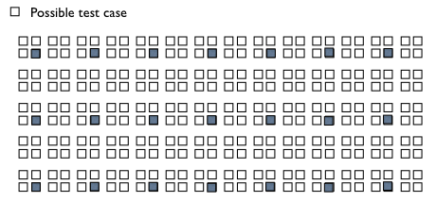
Coverage Criteria
Coverage criteria describe a finite subset of test cases out of the vast/infinite number of possible tests we should execute.
Coverage criteria divide the input space to maximize the number of faults found per test case
Coverage criteria provide useful rules for when to stop testing

Slide 5
Benefits of Coverage Criteria
Adequate
Have I got enough tests?
Guidance
Where should I test more?
Automation
Generate test that satisfies a test requirement
Notes:
Review
Test case
Test set

Slide 6
Changing Notions in Testing
Old view (phase)
New view
(structures and criteria)
Input space (sets)
A: {0, 1, >1}
B: {undergraduate, graduate}
C: {1000, 2000, 3000, 4000}
Requirements
Analysis
Acceptance
Test
Architectural
Design
System
Test
Graphs
Subsystem
Design
Integration
Test
Logical expressions
Detailed
Design
Module
Test
(not X or not Y) and A and B
Implementation
Unit
Test
Syntax structures (grammar)
if (x > y)
z = x - y;
else
z = 2 * x;
[AO, p 12]

Slide 7
New: Structures and Criteria
Test design is largely the same at each phase
Creating the structure is different
Choosing values and automating the tests is different
Tester defines a structure of the software and then find ways to cover it
Structures can be extracted from lots of software artifacts
Graphs – from UML use cases, finite state machines, source code, …
Logical expressions – from decisions in program source, guards on transitions, conditionals in use cases, ...
Input space (sets)
A: {0, 1, >1}
B: {undergraduate, graduate}
C: {1000, 2000, 3000, 4000}
Graphs
Logical expressions
(not X or not Y) and A and B
Syntax structures (grammar)
if (x > y)
z = x - y;
else
z = 2 * x;

Slide 8
Test Coverage Criteria
Coverage Criterion
A rule or collection of rules that impose test requirements on a test set
Test requirement
A specific element of a software artifact that a test case must satisfy or cover
Depends on the specific artifact under test
Test case
A set of test inputs, execution conditions, and expected results, developed for a particular test scenario to verify whether the system under test satisfies a specific requirement
Test set
A set of test cases
Review
Notes:
Review
Test case
Test set

Slide 9
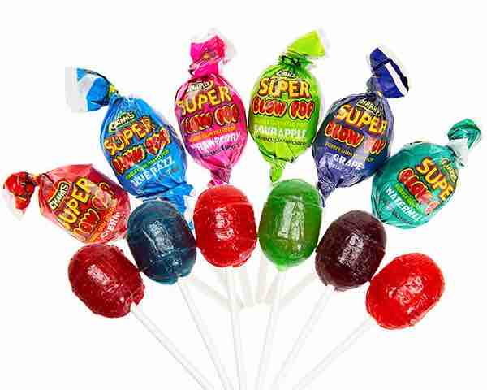
Example: Blow Pop Coverage
Flavors
Cherry
Blue razz berry
Strawberry
Sour apple
Grape
Watermelon
Colors
Red (Cherry, strawberry, watermelon)
Blue (Blue razz berry)
Green (Sour apple)
Purple (Grape)
Possible coverage criteria:
C1: Taste one blow pop of each flavor
(deciding if red blow pop is cherry, strawberry, or watermelon is a controllability problem)
C2: Taste one blow pop of each color

Slide 10
Example: Blow Pop Coverage
Flavors
Cherry
Blue razz berry
Strawberry
Sour apple
Grape
Watermelon
Test requirements for C1
tr1: Cherry
tr2: Blue razz berry
tr3: Strawberry
tr4: Sour apple
tr5: Grape
tr6: Watermelon
TR1 = {Cherry, Blue razz berry, Strawberry, Sour apple, Grape, Watermelon}
Colors
Red (Cherry, strawberry, watermelon)
Blue (Blue razz berry)
Green (Sour apple)
Purple (Grape)
Test requirements for C2
tr1: Red
tr2: Blue
tr3: Green
tr4: Purple
TR2 = {Red, Blue, Green, Purple}

Slide 11
Example: Source Code
NPE-B1
B1
B2
Test requirements for line coverage
TR = {line1, line2, line3, line4, line5}
Test requirements for branch coverage
TR = {NPE-B1, B1, !B1, B2, !B2}

Slide 12
Coverage
Given a set of test requirements TR for coverage criterion C, a test set T satisfies C coverage if and only if for every test requirement tr in TR, there is at least one test t in T such that t satisfies tr

Slide 13
Blow Pop Coverage (continue)
C1: Flavor criterion
TR1 = {Cherry, Blue razz berry, Strawberry, Sour apple, Grape, Watermelon}
Test sets
T1 = {one Cherry, one Blue razz berry, three Strawberries, one Sour apple, two Grapes, four Watermelons}
T2 = {one Blue razz berry, one Sour apple, two Grapes, three Watermelons}
Satisfy C1?
Satisfy C2?
C2: Color criterion
TR2 = {Red, Blue, Green, Purple}
Satisfy C1?
Satisfy C2?

Slide 14
Coverage Level
It is sometimes expensive to satisfy a coverage criterion.
Testers compromise by trying to achieve a certain coverage level.
Coverage level = number of test requirements satisfied by T
Size of TR

Slide 15
Blow Pop Coverage (continue)
C1: Flavor criterion
TR1 = {Cherry, Blue razz berry, Strawberry, Sour apple, Grape, Watermelon}
Test sets
T1 = {one Cherry, one Blue razz berry, three Strawberries, one Sour apple, two Grapes, four Watermelons}
T2 = {one Blue razz berry, one Sour apple, two Grapes, three Watermelons}
Satisfy C1?
Satisfy C2?
Coverage level 6 / 6
4 / 4
C2: Color criterion
TR2 = {Red, Blue, Green, Purple}
Satisfy C1?
Satisfy C2?
Coverage level 4 / 6
4 / 4

Slide 16
Infeasible Test Requirement
Example:
Imagine if we have the following test requirements
TR = {all sides > 0, all sides = 0, all sides < 0}
Some test requirements are infeasible (i.e., cannot be satisfied)
No test case values exist that meet the test requirements
Example: dead code
Detection of infeasible test requirements is undecidable for most test criteria
100% coverage is usually impossible in practice

Slide 17
Two Ways to Use Test Criteria
Directly generate test case values to satisfy the criterion
Often assumed by the research community
Most obvious way to use criteria
Very hard without automated tools
Generate test values externally and measure against the criterion -- to evaluate existing test sets
Usually favored by industry
Sometimes misleading
If tests do not reach 100% coverage, what does that mean?
We don’t have enough data to tell how much 99% coverage is worse than 100% coverage

Slide 18
Implementation of Test Criteria
Generator
A procedure that automatically generate values to satisfy a criterion
Automated test generation tools
Recognizer
A procedure that decides whether a set of test case values satisfies a criterion
Coverage analysis tools
It is possible to recognize whether test cases satisfy a criterion far more than it is possible to generate tests that satisfy the criterion

Slide 19
Comparing Criteria
Criteria Subsumption
A test criterion C1 subsumes C2 if and only if every set of test cases that satisfies criterion C1 also satisfies C2
Must be true for every test set
test req. for C1
test req. for C2
test req. for C1
test req. for C2
test req. for C1
tr1
tr1
tr1
tr1
tr2
tr2
tr2
tr2
tr3
tr3
tr3
tr3
test req. for C2
tr4
tr5
tr4
tr4
tr4
tr6
C1 subsumes C2
C1 subsumes C2
C1 subsumes C2
C2 subsumes C1

Slide 20
Blow Pop Coverage (Subsume)
C1: Flavor criterion
TR1 = {Cherry, Blue razz berry, Strawberry, Sour apple, Grape, Watermelon}
Test sets
T1 = {one Cherry, one Blue razz berry, three Strawberries, one Sour apple, two Grapes, four Watermelons}
T2 = {one Blue razz berry, one Sour apple, two Grapes, three Watermelons}
Satisfy C1?
Satisfy C2?
Coverage level 6 / 6
4 / 4
C1 subsumes C2
C2: Color criterion
TR2 = {Red, Blue, Green, Purple}
Satisfy C1?
Satisfy C2?
Coverage level 4 / 6
4 / 4

Slide 21
Characteristics of a Good Coverage Criterion
It should be fairly easy compute test requirements automatically
It should be efficient to generate test values
The resulting tests should reveal as many faults as possible
Additional notes:
Subsumption is only a rough approximation of fault revealing capability
Researchers still need to gives us more data on how to compare coverage criteria

Slide 22
Advantages of Using Criteria
Yield fewer tests that are more effective at finding faults
Design test inputs that are more likely to find problems
Increase traceability
Answer the “why” for each test
Support regression testing
Provide stopping rules for testing – “how many test” are needed
Support test automation
Make testing more efficient and effective
Provide grater assurance that the software is of high quality and reliability
More comprehensive
Less overlap
How do we start applying these ideas in practice

Slide 23
Summary
Many companies still use “monkey testing”
A human sits at the keyboard, wiggles the mouse and bangs the keyboard
No automation
Minimal training required
Some companies automate human-designed tests
But companies that use both automation and criteria-based testing save money, find more faults, and build better software

Slide 24
What’s Next?
Structures for Criteria-Based Testing
Four structures for modeling software
Input space
Graph
Logic
Syntax
Source
Source
Source
Applied to
Applied to
Applied to
Design
Specs
Models
Specs
FSMs
Integration
Use cases
DNF
Inputs
Notes:
FSM = Finite State Machine
DNF = Disjunctive Normal Form
Why this order – refer to RIPR model

